Slide 1
Internationalization Features
June 20, 2014
Notes:
Guidewire training materials contain Guidewire proprietary information that is subject to confidentiality and non-disclosure agreements. You agree to use the information in this manual solely for the purpose of training to implement Guidewire software solutions. You also agree not to disclose the information in this manual to third parties or copy this manual without prior written consent from Guidewire. Guidewire training may be given only by Guidewire employees or certified Guidewire partners under the appropriate agreement with Guidewire.
<number>

Slide 2
Describe the significance of separating language and regional format
Recall which PCFs and widgets to always use for person names, contact names, phone numbers, addresses, and money
Configure various PCFs to support regional formats
Identify additional configurations for localization
Notes:
<number>

Slide 3
Separating Language and Regional Formats
Globalization PCFs
Monetary Amount widget
Additional i18n configurations
Notes:
<number>

Slide 4
Guidewire g11n and i18n
Globalization (g11n)
Supporting and expanding the breadth of OOB localization (L10n) coverage
Australia
Japan
US
Canada
France
UK
Germany
Australian Regions
English
Australian Culture
Australian Jurisdictions
Australian Dollar
Japanese Regions
Japanese
Japanese Culture
JP Jurisdictions
Japanese Yen
US Regions
English
US Culture
US Jurisdictions
US Dollar
Canadian Regions
English & French
Canadian Cultures
CA Jurisdictions
Canadian Dollar
French Regions
French
French Culture
FR Jurisdictions
Euro
UK Regions
English
British Culture
UK Jurisdictions
Pound Sterling
German Regions
German
German Culture
DE Jurisdictions
Euro
Internationalization (i18n)
Globalization
Locations
Languages
Cultures
Jurisdictions
Currencies
Architecture to support multiple
Support for the configuration of individual
Appropriate separation of support for
Lack of centricity on or ties to a particular subset of
Supporting and expanding the depth of OOB internationalization capability
Notes:
I18N: Internationalization is the foundation to support any and multiple markets (languages, cultural preferences, locations,
jurisdictions, and currencies) with appropriate separation from the rest of the code base and without
reliance or centricity on any one market. I18N is something that is done from the ground up for a
product. By itself, it offers no localization at all.
L10N: Localization supports languages, cultural preferences, locations, jurisdictions, and currencies for a
particular target market (e.g. Japan). L10N is something that is done once per market and relies on the
I18N architecture and I18N configuration capability. Commonly misunderstood fact: Translation is only
one part of localization.
G11N: Globalization is the continuous process of supporting and expanding the breadth of localization and the
depth of internationalization. A fully globalized product works everywhere in the world, supports
every language, etc. In other words, it's an ideal.
Guidewire applications support a core set of regional formats and provide the ability for to provide support for others.
<number>

Slide 5
Understanding L10n
Language
Displayed strings, search and sorting algorithms
Currency
Display, arithmetic, rounding, symbol
Jurisdiction
Insurance, VAT, sales tax
Location
Address formats
Phone formats
Regional formats for
Person names, company names, numbers, dates and times
Jurisdiction
Currency
Location
Language
Localization
Regional formats
Notes:
Localization is adapting a product or service to a particular language and culture.
<number>

Slide 6
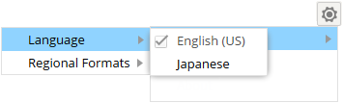
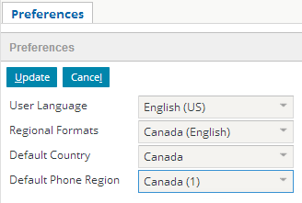
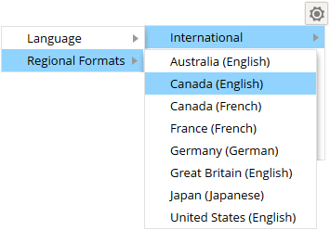
Language and regional format
Independently select
User Preferences
Language
Regional Formats
Default Country
Default Phone Region
Options → International
Language
English (US) default
Other languages require language packs
Regional Formats
Core locales
Notes:
A Guidewire application user can select independently language and regional formats by selecting International from the Options menu at the top, right-hand side of the application screen. International selections in the Options menu are reflected in user preferences. A user can also update their user preferences and select a preferred language, regional format, default county, and default phone regions. Selections for Language and Regional Format are likewise reflected in the International menu. Administrator users can also edit users preferences for a specific user’s extended profile.
A Guidewire application hides the Language submenu if only one language is installed, which is the default configuration. If only one locale is configured, then this menu will be hidden. The menu is hidden completely if only one language and locale is configured for the application.
<number>

Slide 7
Regional format determines…
Date and Time
Number
Currency Symbol
Calendar
Names
Example
03/02/2013
March 2, 2013 or 3 Mar, 2013
Base configuration regional formats:
Australia (English), Canada (English), Canada (French), France (French), Germany (German), Great Britain (English), Japan (Japanese), United States (English)
Notes:
The base configuration of Guidewire applications contains eight regional formats (sometimes called “locales”) that a user can select. In the toolbar, from the Options menu at the top, a user can select a specific regional format (locale). Locale codes are typically encoded as language + region. The following are the locale codes that support base core locales:
en_US = English United States
en_GB = English Great Britain
en_AU = English Australia
en_CA = English Canada
fr_CA = French Canada
fr_FR = French France
de_DE = German Germany
jp_JP = Japanese Japan
<number>

Slide 8
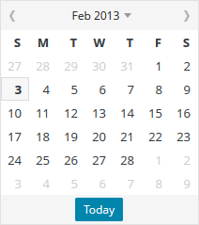
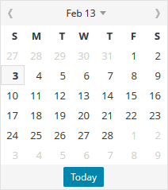
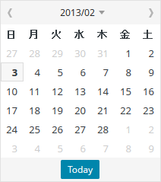
Example: regional format and dates
02/03/2013
February 3, 2013
03/02/2013
3 Feb 2013
2013-02-03 平成 25年2月3日
United States (English)
Australia (English)
Japan (Japanese)
Notes:
In this example, the regional format determines the date format for entering and displaying dates.. Support for regional formats means that users can view and edit, for example dates, as they expect to view and edit dates. It is also possible to configure the calendar date format for the specific locale. For the Japan locale, Guidewire supports the Japanese Imperial Calendar. See the Globalization Guide documentation for more details.
<number>

Slide 9
Creating a new regional format
Create a LocaleType typecode
Create a locale folder and localization.xml file
Optional when non-default behavior required
Notes:
<number>

Slide 10
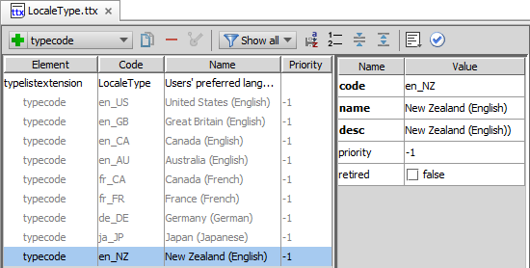
Step 1: Create a LocaleType typecode
Create a typelist extension for LocaleType
Add new typecode: code, name, desc
Notes:
The internal LocaleType typelist determines the available selection of core regional formats in the Options menu. It is possible to create and configure additional locales.
In order to create an additional locale typecode, you must first create a LocaleType typelist extension file in ../config/extensions /typelist/ and then add a new typecode to the LocaleType.ttx file.
The Project view for the Guidewire application displays an alias for the locale folder that reads Localizations.
<number>

Slide 11
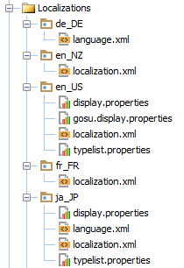
When to create a localization.xml file?
Just for non-default values!
Localization.xml file for a locale typecode is not required
Settings override ICU library defaults
International Components for Unicode (ICU)
Already contains default values!
ICU4J is java library for i18n and g11n
Guidewire applications use the ICU library for
Dates and times
Numbers and monetary amounts
Japanese calendar
Notes:
If a localization.xml document is not defined for a LocaleType typecode, then a Guidewire application will use the ICU library for regional formats. . Guidewire application use the ICU library for regional formats for dates, times, numbers, and monetary amounts that users enter and retrieve in the application. In addition, Guidewire applications use the ICU library for the Japanese calendar.
For example, if a <CurrencyFormat/> element is not described, Guidewire applications implement the ICU (International Component for Unicode) library from IBM to render currency amounts
<number>

Slide 12
Step 2a: [Optional] create locale folder
Create package (folder) with locale naming convention
Physical folder is
…\<AppName>\modules\configuration\config\locale
Localizations is the project view alias for the locale folder
Localization.xml is optional
International Components for Unicode (ICU) is default for localization configuration settings
Notes:
The localization.xml must contain in the GWLocale element values for both the typecode and code attributes that match the typecode code attribute value in the LocaleType typelist.
<number>

Slide 13
Step 2b: [Optional] create localization.xml
<?xml version="1.0" encoding="UTF-8"?> <Localization xmlns="http://guidewire.com/localization"> <GWLocale code="en_NZ" name="English (New Zealand)" typecode="en_NZ"> <DateFormat long="EEEE, d MMMM y" medium="d MMMM y" short="d/MM/yy"/> <TimeFormat long="hh:mm aa" medium="hh:mm aa" short="hh:mm aa"/> <NumberFormat decimalSymbol="." thousandsSymbol=","/> <CurrencyFormat negativePattern="($#)" positivePattern="$#" zeroValue="-"/> </GWLocale> </Localization>
<GWLocale />
Code and typecode must match typelist attribute values
Various formats descriptions possible
Format settings influence widgets
Example: Date format for short affects date picker widget display
Notes:
Typically, a locale describes three date and time formats: Short, Medium, and Long. Both the medium and long formats for date and time patterns are supported by the Java class SimpleDateFormat. These formats are often used to display dates and times in the Guidewire application. Guidewire applications use the short format for the date picker widget. This short format must support a fixed length, for instance yyyymmddhhss.
NumberFormat is a sub-element of GWLocale and contains the thousandsSymbol and the decimalSymbol attributes. The decimalSymbol attribute separates a whole number from its decimal fraction. This is typically a period or comma. The thousandsSymbol attribute separates groups of three digits to the left of the decimal mark. This is typically a comma, period, apostrophe, or, depending on culture, space. Some users may switch locales specifically to improve the efficiency of data entry for numbers.
Guidewire applications support multiple currency formats. The Guidewire applications use the CurrencyFormat settings in the localization.xml file to format the money amount, depending on the locale of the user. The localization.xsd file describes a <NameFormat/> sub-element with three attributes: PCFMode, textFormatMode, and visibileFields. The globalization name widgets support modal options for localized names, including a US-Japan multinational implementation to show four fields to Japanese users and two for American English users. For example, for FR:
<NameFormat visibleFields="Prefix,FirstName,MiddleName,Particle,LastName,Suffix,Name"/>
<number>

Slide 14
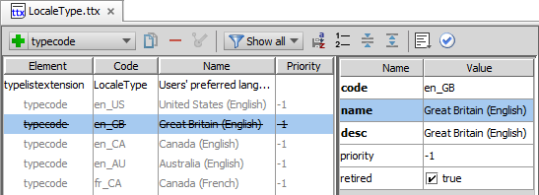
Removing a regional format
In the LocaleType typelist extension, select the typecode to remove
To remove an internal typecode, override and set the retired property to true
To remove an extension typecode, delete or retire
Notes:
To remove an existing regional format from LocaleType.tti, in the typelist extension, override the value and set the retired property to true. If it is a locale that was added to the typelist extension, you can delete the typecode and or retire the value (typically, you retire typecode that have been in use).
<number>

Slide 15
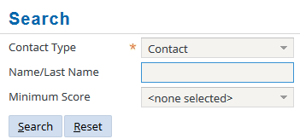
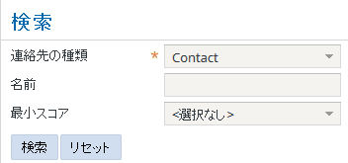
Language determines…
Language for the user interface
Search results
Sorting behavior
Renée
Renée
Notes:
If there is more than one language configured in a Guidewire application, in the toolbar, from the Options menu at the top, a user can select select a specific language. A user's language selection not only updates the language of the application user interface, it also affects application behavior in at least two significant ways: searching and sorting.
<number>

Slide 16
Language Packs
Guidewire provides language packs, and thus support, for the following
English (US) is base configuration
Italian
German
Spanish
French
Chinese
Japanese
Install a language pack to view other languages *
LanguageType.ttx determines the language choices that the Option menu displays
* Language packs installation not covered in this lesson
Notes:
For details on installing language packs, please refer to the Globalization Guide documentation.
<number>

Slide 17
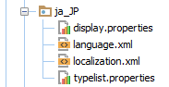
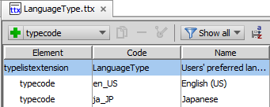
Language configuration
In the Localizations folder
Example:
…/config/locale/ja_JP
Localized files
display.properties
typelist.properties
Language.xml (optional)
Defines search and sort collations
LanguageType.ttx
Required for menu selection
Notes:
For a specific Guidewire application, you install a language pack. The installation of a language pack manages all configuration settings, files, and database upgrades.
The Project view for the Guidewire application displays an alias for the locale folder that reads Localizations.
The minimum configuration for adding a language is to have a language.xml file in a given locale folder, a defined typecode in the LanguageType typelist, and collation definition for a given database collation in the collations.xml.
<number>

Slide 18
language.xml advanced configurations
1 <?xml version="1.0" encoding="UTF-8"?> 2 <Language xmlns="http://guidewire.com/language"> 3 <GWLanguage code="ja_JP" name="Japanese (Japan)" typecode="ja_JP"> 4 <LinguisticSearchCollation strength="primary"/> 5 <SortCollation strength="secondary"/> 6 </GWLanguage> 7 </Language>
<GWLangauge />
Code and typecode must match typelist attribute values
Linguistic Search Collation
Sort Collation
Collation strength defined in collations.xml
Notes:
LinguisticSearchCollation defines the linguistic search collation strength for a given language. Linguistic search applies a specific collation to the character data. This is different from treating the character data as binary code and then comparing and sorting data numerically. For example in German, ä, ö, ü are equal to ae, oe and ue, respectively.
Guidewire applications create a searchable column to support search collation and then populate this column according to the LinguisticSearchCollation settings with a denomarlized value. Search page results are sorted by the denorm columns according to search collation strength and rules, not the sort collation strength.
SortCollation defines the sorting collation strength for the given language. "Primary" is a setting value for the strength attribute that considers only character weights, "secondary" also considers accent differences, and "tertiary" also considers casing.
Collation determines comparison (search) and sorting algorithms. Collation strength refers to how selective (or restrictive) the search and sort code treats the collation process. Guidewire applications handle searching and sorting of character data differently for database and in-memory storage operations. For database data, the RDBMS performs the operations and applies the rules for comparing (search) and sorting. For in-memory data, code performs the operations for comparison and sorting operations. This includes non-query list views, drop-downs, and other user interface items.
<number>

Slide 19
Separating Language and Regional Formats
Globalization PCFs
Monetary Amount widget
Additional i18n configurations
Notes:
<number>

Slide 20
Globalization PCFs
 | Contact name | Person name | Address | Any phone number
GlobalContactNameInputSet (PCF) | X
GlobalPersonNameInputSet (PCF) |  | X
GlobalAddressInputSet (PCF) |  |  | X
GlobalPhoneInputSet (PCF) |  |  |  | X
Notes:
For an address, use the GlobalAddressInputSet.pcf.
For a contact name, use the GlobalContactNameInputSet.pcf.
For a person name, use GlobalPersonNameInputSet.pcf
For a phone number, use GlobalPhoneInputSet.pcf.
<number>

Slide 21
Globalization PCFs
Support ALL core locales
Easily extendable to support other locales
Always use for
Addresses
Names for contact
Names for people
Phone numbers
PCF files
GlobalAddressInputSet
GlobalContactNameInputSet
GlobalPersonNameInputSet
GlobalPhoneInputSet
More than just PCF files!
Entities
GlobalAddress
GlobalContactName
GlobalPersonName
API classes
gw.api.name
gw.api.phone
gw.api.address
Formatters
NameFormatter
AddressFormatter
phoneOnwer.Format()
Libraries
libphonenumber
Notes:
These slide shows some of the Globalization widgets used for both read-only and edit modes. Other widgets include search widgets and search result widgets. These widgets are not covered in this lesson.
<number>

Slide 22


GlobalContactNameInputSet
Use for ALL contact names, except Person
Company
Company Vendor
default
Name
Japan
Name Summary
Name (Phonetic)
Name Kanji
Japan uses Kanji name for display and phonetic for sorting
Phonetic name would typically be in katakana or hiragana rather than in Roman characters
Notes:
GlobalContactNameInputSet supports names for contacts. GlobalPersonNameInputSet supports names for people. Name Summary is a read-only field.
<number>

Slide 23
gw.api.name
ContactNameFields interface describes name properties for non-Persons:
Name
NameKanji
ContactNameDelegate
Implements the ContactNameFields interface and the creates object
NameOwner interface for GlobalContactNameInputSet
Determines the availability, editability, visibility and targeted PostOnChange for specific fields in the input set UI
ContactNameOwner is the base configuration implementation
NameFormatter
Contains method to format a contact for a given locale
See ABCompany.en (entity name) for an example
Notes:
gw.api.name.ContactFields is an interface that represents any type of contact name. The default implementation of the ContactNameFields interface is the ContactNameDelegate Gosu class. When provided with a contact bean, this class wraps the name related columns into a ContactNameDelegate object.
gw.api.name.NameOwner is the interface for the GlobalContactNameInputSet.pcf. The implementation defines the user interface behavior such as availability, editability, visibility and targeted PostOnChange for specific input set fields. The base configuration implementation is ContactNameOwner.
<number>

Slide 24
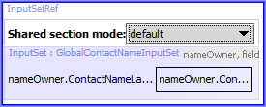
Using GlobalContactNameInputSet.pcf
Add InputSetRef widget
Specify def()
GlobalContactNameInputSet
ContactNameOwner
ABContactNameDelegate *
Specify mode
NameLocaleSettings
Specify def()
Specify mode
* AB is a product identifier specific to ContactManager and TrainingApp
GlobalContactNameInputSet(new gw.api.name.ContactNameOwner( new gw.api.name.ABContactNameDelegate(contact as ABCompany * )))
gw.api.name.NameLocaleSettings.PCFMode
Notes:
Use the GlobalContactNameInputSet wherever you have a contact name. Add an InpsetSetRef widget to the PCF. In the widget, specify the def() property to use the GlobalContactNameInputSet. An inputSet requires a nameOwner and the related fields. Next, specify the mode property. gw.api.name.NameLocaleSettings is a class that provides locale-specific name settings. If not specified for the locale, the class specifies the default fields to show when editing a name and the fields in the display names. Otherwise, the class uses the NameFormat definition as described in the localizations.xml file for a given locale (a locale in this sense is of the type GWLocale) to define the visible fields.
<number>

Slide 25
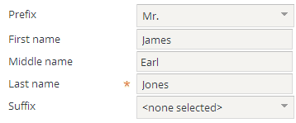
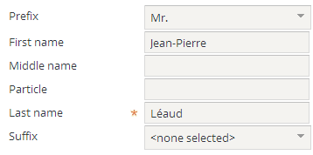
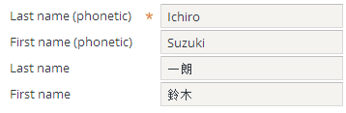
GlobalPersonNameInputSet
Use for ALL person names
Supports core locales
fr_FR locale support
Shows particle field
ja_JP locale support
Provide phonetic and Knaji
Notes:
GlobalPersonNameInputSet supports the core locales for Guidewire applications. Besides the French-France (fr_FR) locale, the editing of the name will be in the order of Prefix, First Name, Middle Name, Last Name, and Suffix. The read-only display may omit the middle name. For French-France (fr_FR), the editing of a name will include the Particle field after the Middle Name and the read-only display will likewise omit the middle name and show the following: Prefix, Particle, Last Name, and First Name. Name Summary is a read-only field.
<number>

Slide 26
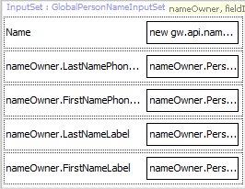
GlobalPersonNameInputSet.Japan
Japan
Name Summary
Last Name (Phonetic)
First Name (Phonetic)
Last Name Kanji
First Name Kanji
jp_JP locale support
Phonetic
Kanji
すずき いちろう
su zu ki i chi ro —
鈴木 一朗
Suzuki
Ichiro
Notes:
For the display of Japanese names, the format is first surname then given name, first rendered in Kanji, if Kanji is used. Name Summary is a read-only field. The phonetic example is furigana for the name of the baseball player Suzuki Ichiro. Furigana is written in Hiragana and is used to disambiguate pronunciations and kanji representations. Hiragana is a Japanese syllabary and is a part of the kana system. (Katakana is the other part of the kana system). Hiragana is often used to write native words for which there is no kanji. In Japanese, one kanji can have many pronunciations and one pronunciation can have many kanji representations.
<number>

Slide 27
gw.api.name
PersonNameFields interface describes name properties for persons:
FirstName, MiddleName, Particl, LastName, Prefix, Suffix, FirstNameKanji, LastNameKanji
PersonNameDelegate
Implements the PersonNameFields interface and creates the object
NameOwner interface for GlobalPersonNameInputSet
Determines the availability, editability, visibility and targeted PostOnChange for specific fields in the input set UI
ContactNameOwner is the base configuration implementation
NameFormatter
Contains method to format a contact for a given locale
See ABPerson.en (entity name) for an example
Notes:
gw.api.name.PersonFields is an interface that represents any type of person name. The default implementation of the PersonNameFields interface is the ABPersonNameDelegate Gosu class. When provided with a contact bean, this class wraps the name related columns into a ABPersonNameDelegate object.
gw.api.name.NameOwner is the interface for the GlobalPersonNameInputSet.pcf. The implementation defines the user interface behavior such as availability, editability, visibility and targeted PostOnChange behavior. The base configuration implementation is ContactNameOwner.
<number>

Slide 28
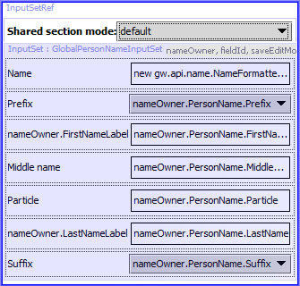
Using the GlobalPersonNameInputSet
Add InputSetRef widget
Specify def()
GlobalContactNameInputSet
ContactNameOwner
ABContactNameDelegate *
Specify mode
NameLocaleSettings
Specify def()
Specify mode
GlobalPersonNameInputSet(new gw.api.name.ContactNameOwner( new gw.api.name.ABPersonNameDelegate(contact as ABPerson*)))
* AB is a product identifier specific to ContactManager and TrainingApp
gw.api.name.NameLocaleSettings.PCFMode
Notes:
Use the GlobalPersonNameInputSet wherever you have a person name. Add an InpsetSetRef widget to the PCF. In the widget, specify the def() property to use the GlobalPersonNameInputSet. An inputSet requires a nameOwner and the related fields. Next, specify the mode property. gw.api.name.NameLocaleSettings is a class that provides locale-specific name settings. If not specified for the locale, the class specifies the default fields to show when editing a name and the fields in the display names. Otherwise, the class uses the NameFormat definition as described in the localizations.xml file for a given locale (a locale in this sense is of the type GWLocale) to define the visible fields.
Example:
<NameFormat PCFMode="Japan" textFormatMode="Japan" visibleFields="LastName,FirstName,LastNameKanji,FirstNameKanji,Name,NameKanji" />
In the NameFormat example for Japan, the PCFMode describes the modal widget, the TextFormat describes the textformatting mode to use for the locale, and visibleField describes the list of fields that appear in names the locale.
<number>

Slide 29
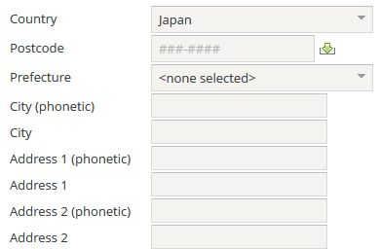
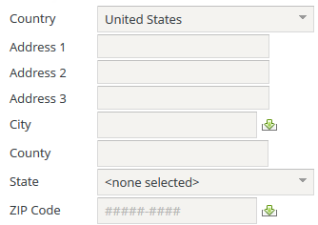
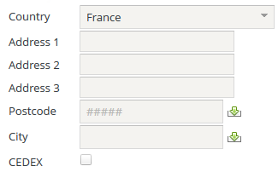
GlobalAddressInputSet.pcf
Use for ALL addresses
Renders addresses both in edit and in read-only
Country selection triggers PCF Mode change
Determines visible and available fields including field labels, watermarks, and validation
Notes:
The Country field controls the format of the PCF and determines what fields are visible, in what order, and the labels for certain fields (e.g. “State” vs “Province” versus “Prefecture” for the State field).
<number>

Slide 30
GlobalAddressInputSet modes
default
BigToSmall
PostCodeBeforeCity
Address Summary
Country
Address Line1
Address Line 2
Address Line 3
City
County
State/Province
Postal Code
Country
Postal Code
Prefecture
City (phonetic)
City
Address Line 1 (phonetic)
Address Line 1
Address Line 2 (phonetic)
Address Line 2
Country
AddressLine1
Address Line 2
Address Line 3
Postal Code
City
CEDEX flag
CEDEX Bureau
Notes:
Three PCF modes cover the countries/regions in the base configuration of a Guidewire application. Each PCF mode defines a specific address field order for both read-only and edit modes.
When the selected country is Japan, Kanji fields are visible and available. When the selected country is Canada, the State field is not visible but the Province fields is visible and available.
The CEDEX (Courrier d'Entreprise à Distribution Exceptionnelle) is for France and is the equivalent of PO Box in the United States. It is typically associated with certain addresses that receive large volumes of mail. In other cases, the Cedex may refer to a district as in 75896 Paris cedex 07 (the "07" is the number of the district).
<number>

Slide 31
gw.api.address
AddressFillable interface describes the address fields
AddressLine1, AddressLine2, AddressLine3, City, Country, County, PostalCode, State
AddressFillableExtension extends AddressFillable
jp_JP and fr_FR regional format
AddressEntityDelegate
Delegate for the address entity
Implements AddressFillableExtension and creates the AddressOwner object
Notes:
gw.api.address.AddressFillable is an interface that represents any type of address. AddressFillableExtension extends the interface with properties that support fr_FR and jp_JP regional formats for addresses.
The default implementation of the AddressFillableExtension interface is the AddressEntityDelegate Gosu class.
<number>

Slide 32
gw.api.address (2)
AddressOwner interface for GlobalAddressInputSet
Provides way to set and get a single address for an enclosing entity
Implementation defines user interface behavior including
Availability, editability, and visibility
Selected mode, default country and selected country
SecondaryAddressOwner * class
In the constructor, uses Address type (Address.eti)
Used as wrapper for secondary contacts in GlobalAddressInputSet
* Class specific to ContactManager and TrainingApp
Notes:
gw.api.address.AddressOwner is the interface for the GlobalAddressInputSet.pcf. The implementation defines the user interface behavior such as availability, editability, visibility, and targeted Post On Change behavior. This includes the selected mode, default country, and selected country. The base configuration implementation is AddressOwner.
SecondaryAddressOwner() is an additional wrapper implementation for secondary contacts and differs in that it use an address (not an addressOwner) in the constructor.
<number>

Slide 33
gw.api.address (3)
AddressFormatter
Contains method to format an address for a given regional format
01 var formatter = new gw.api.address.AddressFormatter() {
02 :Country = country,
03 :AddressLine1 = addressLine1,
04 :AddressLine2 = addressLine2,
05 :AddressLine3 = addressLine3,
06 :City = city,
07 :County = county,
08 :State = stateCode,
09 :PostalCode = postalCode,
10 :AddressLine1Kanji = addressLine1Kanji,
11 :AddressLine2Kanji = addressLine2Kanji,
12 :CityKanji = cityKanji,
13 :CEDEX = CEDEX,
14 :CEDEXBureau = CEDEXBureau
15} 16 print(formatter.format(formatter, "\n"))
Notes:
The address formatter is built to abstract out address display for internationalization. When address columns are changed, this formatter and its usages (which may omit certain fields) should be updated accordingly. See Address.en (entity display name) for more detailed examples.
<number>

Slide 34
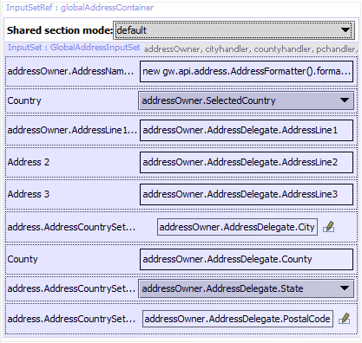
Using the GlobalAddressInputSet
Add InputSetRef widget
Specify def()
GlobalAddressInputSet
AddressOwner
Define ID as
globalAddressContainer
Specify mode
Expression to determine mode based on country
Specify def()
Specify mode
GlobalAddressInputSet(addressOwner)
address.AddressCountrySettings.getSettings( addressOwner.SelectedCountry).PCFMode
Notes:
Use the GlobalAddressInputSet wherever you have an address. Add an InpsetSetRef widget to the PCF. In the widget, specify the def() property to use the GlobalAddressInputSet. The inputSet requires an AddressOwner. Next, specify the ID property as globalAddressContainer. A value change in the Country field triggers a partial page update (targeted post on change) that targets the globalAddressContainer widget. In other words, the target is defined specifically as globalAddressContainer and as such, necessitates that the ID of the container widget must use the globalAddressContainer as the ID value.
Next specify the mode. The mode property of the container widget evaluates this (or similar) expression:
address.AddressCountrySettings.getSettings(addressOwner.SelectedCountry).PCFMode. The resulting PCFMode value determines which input set to render: default, BigToSmall, or PostCodeBeforeCity.
To learn more about working with the GlobalAddressInputSet.pcf, refer to the Globalization Guide in documentation.
<number>

Slide 35
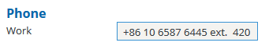
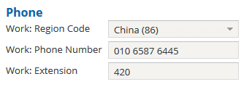
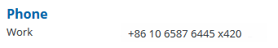
GlobalPhoneInputSet
International numbers, variable length, and extensions all supported
Edit mode validation
Displays region
Displays extension
Gosu validation
Read-only shows formatted number
Edit mode: Validation
Edit mode: Displays composite fields
Read-only: Formatted number
Notes:
The GlobalPhoneInputSet helps Guidewire applications to utilize and enforce internationally accepted standards for phone numbers. One benefit of the GlobalPhoneInputSet is that it does not utilize an input mask, and instead, utilizes Gosu validation. This allows for flexible data lengths of phone numbers whereas an input mask requires fixed length data. In addition, only storing the number itself without formatting saves space in the database and minimizes data conversions.
The GlobalPhoneInputSet widget allows for dynamic data entry by parsing out the country code, number formatting, and if applicable, the extension. Only numeric data is stored, however. In read-only mode, the widget displays a phone number as a formatted value of Country Code, National Subscriber Number, and Extension.
In edit mode, whenever a user enters a plus sign (+) to begin entering an international phone number, the GlobalPhoneInputSet widget issues a targeted post-on-change event to expose a PhoneCountryCode (Region Code label) drop-down list. The dropdown list automatically selects the corresponding country and formats the phone number using the phone format for that phone region.
Whenever a user enters a number phone number without first entering a phone country code, then only the format action is invoked on a targeted post-on-change event. Also, only the format action is invoked if the country code is the same as the user’s selected default or default configured for the server.
<number>

Slide 36
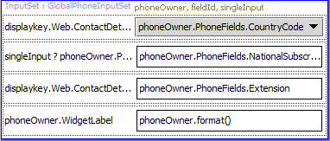
GlobalPhoneInputSet.pcf
Use for ALL phone numbers worldwide
CountryCode
Typekey from PhoneCountryCode.tti
National Subscriber Number
Phone number for phone region
Extension
Validates and shows extension
Phone Display
Formats read-only number
Notes:
The GlobalPhoneInputSet.pcf provides all user interface functionality for phone fields.
In read-only mode, the display field is automatically formatted based on the user's default phone country or the server default phone country. Each user can select their default phone country in User Preferences.
The widget's default behavior can be changed to show all available fields through the AlwaysShowRegionCode setting in config.xml.
There is not a one-to-one relationship between country codes and country. Some cell carries offer subscribers country codes that are not specific to their country. In addition, there are exceptions to country codes like the Vatican City. All CountryCode values are available to review in the PhoneCountryCode typelist.
<number>

Slide 37
Three (3) required entity phone fields
<typekey name="CellPhoneCountry" typelist="PhoneCountryCode"/> <column name="CellPhone" type="phone"> <columnParam name="phonecountrycodeProperty" value="CellPhoneCountry"/> <columnParam name="extensionProperty" value="CellPhoneExtension"/> </column>
<column name="CellPhoneExtension" type="varchar"> <columnParam name="size" value="60"/> </column>
Requires typekey for PhoneCountryCode
Column with Phone data type
Two (2) parameters required:
phonecountrycodeProperty and extensionProperty
Column for Phone Extension
Notes:
In this example, the three entity elements describe a cell phone.
CellPhoneCountry is a typekey defined by the PhoneCountryCode typelist. PhoneCountryCode is a new typelist that represents all the phone countries in the world. Country to phone country mapping is not 1:1 (e.g. Vatican City) and the inclusion of the ZZ typecode represents unknown country.
CellPhone is a column defined by the datatype Phone. The column parameters are required. The GlobalPhoneInputSet.pcf expects both a phonecountrycodeProperty and extensionProperty.
The CellPhoneExtension column is a standard varchar field. The size value is 60, but the field only accepts a string that is 7 characters in length (7 is in the millions of extension numbers).
<number>

Slide 38
gw.api.phone
PhoneFields interface describes phone properties:
CountryCode, NationalSubscriberNumber, Extension
PhoneType
ContactPhoneDelegate
Implements the PhoneFields interface and creates the object from the bean and the PhoneType
Automatically sets the PrimaryPhoneType
PhoneOwner interface for GlobalPhoneInputSet
Implementation defines user interface behavior including availability, editability, visibility and targeted PostOnChange
StandardPhoneOwner and BusinessPhoneOwner are base implementations
Notes:
gw.api.phone.PhoneFields is an interface that represents any type of phone number. It contains properties for CountryCode, NationalSubscriberNumber, Extension and PhoneType.
The default implementation of the PhoneFields interface is the ContactPhoneDelegate Gosu class. When a contact bean and a PhoneType are provided as arguments in the constructor, this class wraps the three phone columns into a ContactPhoneDelegate object. The ContactPhoneDelegate also automatically sets the PrimaryPhoneType.
gw.api.phone.PhoneOwner is the interface for the GlobalPhoneInputSet.pcf. The implementation defines the user interface behavior such as availability, editability, visibility and targeted PostOnChange behavior. The base configuration implementation includes StandardPhoneOwner and BusinessPhoneOwner. BusinessPhoneOwner contains an extra extension field in the UI.
<number>

Slide 39
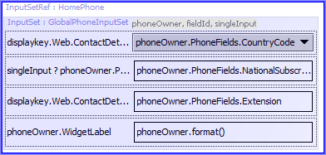
Using GlobalPhoneInputSet.pcf
Add InputSetRef widget
One for each PhoneType: Work, Fax, Home, Generic, Cell
Specify def()
GlobalPhoneInputSet
StandardPhoneOwner
ContactPhoneDelegate
Specify def()
* AB is specific to ContactManager and TrainingApp
GlobalPhoneInputSet(new gw.api.phone.StandardPhoneOwner(new gw.api.phone.ContactPhoneDelegate(anABContact, ABContact#HomePhone), displaykey.Phone.Home, false) *
Notes:
The GlobalPhoneInputSet is initialized by providing the InputSetRef with a PhoneOwner. The ContactPhoneDelegate takes the bean phone columns and the phonetype and intializes and object with the necessary and valid fields. Use the GlobalPhoneInputSet wherever you have a phone number. Add an InpsetSetRef widget to the PCF for each phone type. In the widget, specify the def() property to use the GlobalPhoneNameInputSet. The inputSet requires a StandardPhoneOwner and the related fields.
<number>

Slide 40
Related phone number APIs
gw.api.util.GWPhoneNumber
Interface for the standard Guidewire phone number
gw.api.util.GWPhoneNumberBuilder
Builds a formatted number including formatting characters for locale
gw.api.util.PhoneUtil
Methods to normalizes, parse, and manipulate phone numbers
gw.datatype.persistence. PhoneDataTypePersistenceHandler
Normalizes phone numbers when bean is edited
Notes:
<number>

Slide 41
Related phone number APIs (2)
gw.plugin.phone.IPhoneNormalizerPlugin
Interface for the phone normalizer
gw.api.phone.DefaultPhoneNormalizerPlugin
Implements IPhoneNormalizerPlugin and normalizes any possible string by stripping out formatting characters.
Notes:
To learn more about working with the GlobalPhoneInputSet.pcf, refer to the Globalization Guide in documentation.
<number>

Slide 42
Related phone number APIs (3)
<ValidatorDef description="Validator.Phone" name="Phone" validation-type="gosu" value="gw.api.validation.PhoneValidator"/>
gw.api.validation.PhoneValidator
Defined in FieldValidators.xml
…<AppName>\modules\configuration\config\ fieldvalidators\fieldvalidators.xml
Default phone validation mechanism
Triggered when phone country is set
Implements Google's libphonenumber library
Notes:
PhoneValidator provide entity field validation for phone numbers. PhoneValidator implements Google's open source libphonenumber library. The library provides customers the opportunity to configure metadata to handle changing business and telecom conditions.
To enable the new PhoneValidator, you'll need to configure fieldvalidators.xml with a fully qualified name (example below). Please take special note of the validation-type="gosu" attribute.
The validator will NOT be triggered if the associated phone country is not set. This is to maintain backwards compatibility with old data.
<number>

Slide 43
Separating Language and Regional Formats
Globalization PCFs
Monetary Amount widget
Additional i18n configurations
Notes:
<number>

Slide 44
MonetaryAmount data element for money
Use for ALL money
Two columns
Amount
Currency
Amount Range
any, positive, negative, nonpositive, nonnegative
<monetaryamount amountColumnName="amount" amountRange="positive" currencyColumnName="currency" name="InteractionAmount_Ext"
… precision="10"
scale="3" />
Precision
maximum number of digits used in the number
Scale
maximum number decimal places
gw.pl.currency.MonetaryAmount
Big Decimal math
Notes:
As a data element, MonetaryAmount features two columns in the database: the amount and the currency. A new class, gw.pl.currency.MonetaryAmount defines it.
Currency is tracked along with the amount internally. For computations, you can just add two monetary amounts provided they are of the same currency. Calculations prior to persisting the result are done using high-precision arithmetic, and the final amount is rounded and to save as MonetaryAmount. In the XML example, precision refers to a number that is a total of 10 digits. Scale describes that out this 10 digits, 3 digits are reserved for decimal places. The result is a number with 7 digits to the left of the decimal and 3 digits to the right for a total of 10 digits. The maximum value of the example is 9999999.999.
<number>

Slide 45
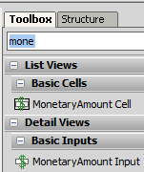

MonetaryAmount widgets for money
Two widgets
Currency property value
SINGLE
DefaultApplicationCurrency
Use typekey expression
MULTIPLE
Consider business logic
Use expression to programmatically set value
MonetaryAmount Cell
ListView input for money
MonetaryAmount Input
Input for money
Notes:
Two new widgets, MonetaryAmount cell or MonetaryAmountInput cell, displays the monetary value and the currency as well as supports the editing of both the monetary value and related currency.
<number>

Slide 46
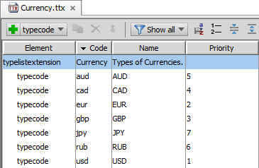
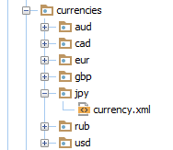
Define currency in Currency.ttx
If only one currency
Retire other typecodes
Multiple currency support
Add additional typecodes
Formatting default from ICU library
Override ICU formatting with per locale
Create currency.xml
Match typecodes
<Currency …> <CurrencyType code="jpy" desc="Japanese Yen" storageScale="0">
Notes:
Currency.xmlis a single file for each typecode currency. Previous versions of Guidewire applications (Diamond) contained currency types and formats in one xml file, currencies.xml. If a <CurrencyFormat/> element is not described in either the currency.xml file or localization.xml file, Guidewire applications implement the ICU (International Component for Unicode) library from IBM to render currency amounts.
Of related interest is the definition of the currency type in a currency.xml file. This file describes the typecode for the currency in the currency typelist, a descriptive reference for the currency, and the storage scale of the decimal value for the currency. It is possible to specify the currency format, including formats for positive, negative, and zero numbers. In the localization.xml file for a given locale, it is possible to override the default currency type and format as described in a given currency.xml file. The <CurrencyFormatOverride /> element in the localization.xsd is identical to CurrencyFormat, but all attributes are optional.
<number>

Slide 47
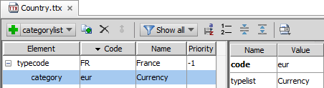
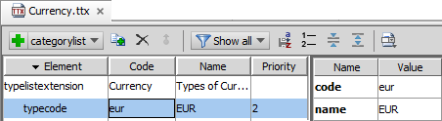
Currency typelist relation example
Country typecode associated with Currency
Example
France jurisdiction associated with Country of France which use the Euro
Notes:
The typelist Country has code FR associated with category eur for Currency which comes from Currency typelist. The code eur has the name EUR in the Currency typelist which is the name in the UI for the currency. For example, when a contact’s primary address is in country France (FR), then the contact’s preferred currency is set to EUR.
There are other relations to the Country typelist, including the State, ZoneType, and Jurisdiction.
<number>

Slide 48
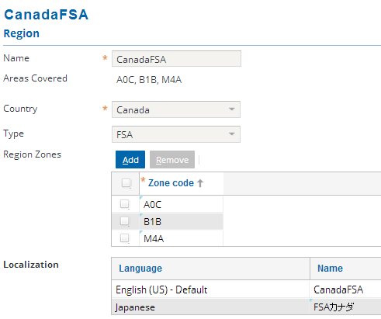
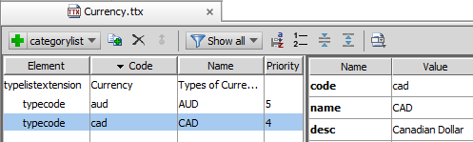
Region and currency
Region defined by region Zone
Region zone
Zone
Country
From country, can retrieve currency
Notes:
A region is a named area that contains one or more states, ZIP codes, or counties. For example, you can define a Western region that includes the states California, Nevada, and Washington. You can also configure the application to use other address elements, such as Canadian provinces, to define regions. Define as many regions as you want. The regions can overlap. State-level regions can describe the office to which a claim is sent. A ZIP code or county-level region might govern which person is assigned to inspect a damaged vehicle. You can assign users and groups to cover one or more regions. You can also associate regions and business rules to provide location-based assignment. A group can cover multiple regions. For example, you define one region to be Arizona and New Mexico, and another region to be all counties in Southern California. You can then assign both these regions to your Southwest Regional Office.
<number>

Slide 49
Separating Language and Locale
Globalization widgets
Additional i18n configurations
Notes:
<number>

Slide 50
More configurations for i18n and L10n
Config.xml defaults for application behavior
Language
Regional Format (locale)
Country
Currency
Phone number specific settings
Multiple currency support
Jurisdiction and JurisdictionType typelists for regulatory definitions
For jp_JP, configuring a date to use the Japanese Imperial Calendar
Search and sorting collations for the database
Create localized application values
Notes:
<number>

Slide 51
Server default settings in config.xml
Language
Locale
Country
Currency
<param name="DefaultApplicationLanguage" value="en_US"/>
<param name="DefaultApplicationLocale" value="en_US"/>
<param name="DefaultCountryCode" value="US"/>
<param name="DefaultApplicationCurrency" value="usd"/>
Notes:
If the application is in single currency mode, then the default application currency is the ONLY currency available to the application.
<number>

Slide 52
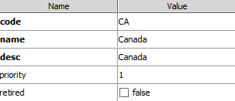
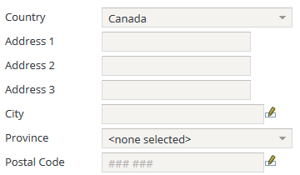
Default settings and typelist example
DefaultCountryCode
Default country for newly created address
Corresponds to ISO two letter code
Code in Country.ttx typelist extension
<param name="DefaultCountryCode" value="CA"/>
Example for Canada
Auto complete for Province
Autofill and input mask for Postal Code
Autofill for city
Notes:
The DefaultCountryCode configuration settings parameter determines the default country selected for newly created addresses.
It is possible to change the ordering of countries in the GlobalAddressInputSet widget for the country TypeKeyInput field. Open the Country.ttx file in Studio. Using the Typelist editor, modify the priority value for the given typecode. For example, the United States has priority of 0 and Canada has priority of 1. To make Germany the third choice, simply change the priority from -1 to 2 for the Germany typecode.
<number>

Slide 53
Phone number settings in config.xml
AlwaysShowPhoneWidgetRegionCode
If set to true, the Region Code will always be visible
DefaultPhoneCountryCode
Server-side setting but can override user preferences
DefaultNANPACountryCode
North American Numbering Plan
<param name="AlwaysShowPhoneWidgetRegionCode" value="false" />
<param name="DefaultPhoneCountryCode" value="US" />
<param name="DefaultNANPACountryCode" value="US" />
Notes:
The North American Numbering Plan (NANP) is an integrated telephone numbering plan serving 20 North American countries that share its resources. These countries include the United States and its territories, Canada, Bermuda, Anguilla, Antigua & Barbuda, the Bahamas, Barbados, the British Virgin Islands, the Cayman Islands, Dominica, the Dominican Republic, Grenada, Jamaica, Montserrat, Sint Maarten, St. Kitts and Nevis, St. Lucia, St. Vincent and the Grenadines, Trinidad and Tobago, and Turks & Caicos.
NANPA countries are assigned country code "1" . NANPA numbers are ten-digit numbers consisting of a three-digit Numbering Plan Area (NPA) code, commonly called an area code, followed by a seven-digit local number.
<number>

Slide 54
MultiCurrencyDisplay mode in config.xml
<param name="MultiCurrencyDisplayMode" value="SINGLE" />
SINGLE
MULTIPLE
Config.xml
DefaultApplicationCurrency is the ONLY currency
Currency.ttx
Delete unused typecodes
/config/currencies
Delete all unused currency.xml files
Config.xml
Set one typekey as default in DefaultApplicationCurrency
Get default currency
gw.api.util. CurrencyUtil. getDefaultCurrency()
Notes:
When in a single currency mode, a Guidewire application assumes that all monetary amounts are in the same currency. In a single-currency deployment, a Guidewire application uses the CurrencyFormat settings in the localization.xml, if specified, to format the money amount. Currency format includes the positive, negative and zero value representations. In a multi-currency deployment, CurrencyFormat is ignored.
<number>

Slide 55
Application resolution for settings
 | Language | Regional Format | Country for Addresses | Currency for Monetary Amount | Phone Region
If defined, use this... | User preferences for User Language | User preferences for Regional Format | User preferences for Default Country | Application context (single vs. multiple support) | User preferences for Default Phone Region
else, use… | Browser’s language (e.g. en_GB will resolve to English) | Default Application Locale in config.xml | Default Country Code in config.xml | Default Application Currency in config.xml | Default Phone Country Code in config.xml
else… | Default Application Language in config.xml
Notes:
<number>

Slide 56
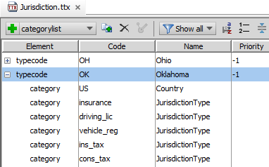
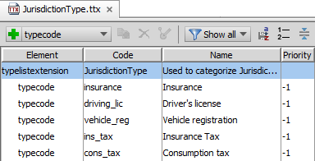
JurisdictionType and Jurisdiction typelists
Typelists represents regulatory jurisdiction
Support multi-jurisdictional deployments
Even within one country
Jurisdiction categories include
Country
Jurisdiction Type
JurisdictionTypes
Insurance, license, vehicle registration, tax, etc.
Notes:
Previous versions of Guidewire applications conflated state and jurisdiction. Emerald introduces a new typelist specifically for Jurisdiction. For the most part, this typelist is identical to the State typelist. However, in a multi-national deployment, the Jurisdiction typelist serves a list of regulatory jurisdictions across the countries where the application is deployed, while the State typelist would be the list of states/provinces within those countries.
To infer a Jurisdiction from an address, take a look at the AddressJurisdictionHandler class which contains various helper methods.
<number>

Slide 57
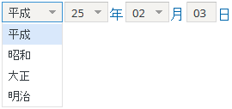
Japanese Imperial Calendar (JIC)
Calendar picker
Drop-down date widget
Ideal for government dates
Separate inputs
Era, Year, Month, Day
Composite inputs support auto-completion
Use japaneseimperialdate datatype for entity
Not configurable on input widget
Default calendar for Japan (Japanese)
Supports ListView cell editing
Notes:
In order to use the Japanese Imperial Calendar, configuration must be done at the entity level and not on an input widget in a PCF. Use the japaneseimperialdate datatype for the entity column.
The drop-down date widget for the JIC can be used in the place of a calendar picker. The reason for this is that JIC dates are mainly used for birthday or vehicle registration dates and that the day of the week is not necessary. There are separate inputs for era, year, month, day, and depending on the PCF configuration, and input for time. Users can type in any value into an input, but the client discards out-of-range values after the loss of focus of the input widget.
<number>

Slide 58
Collations.xml
Determines algorithm for sorting and searching
Defined per database
Locale is for language (changing in upcoming release)
<Collation locale="fr" primary="French_CI_AI" secondary="French_CI_AS" tertiary="French_CS_AS"/>
Primary
Case Insensitive (CI)
Accent Insensitive (AI)
Renée = Renee = renee = renée
Secondary
Case Insensitive (CI)
Accent Sensitive (AS)
Renee = renee
Renée = renée are treated differently.
Tertiary
Case Sensitive (CS)
Accent Sensitive (AS)
Renne <> renee <> Renée <> renée
Notes:
A collation is an overriding set of rules that applies to the ordering and comparison of the data. Collation strength refers to how selective (or restrictive) the search and sort code treats the collation process. For example, collation strength controls whether the search and sort code respects or ignores differences in case and accent on a character. PRIMARY is a setting value for the strength attribute that ignores case and accents in the language text. For example, "Renée", "Renee", "renee" and "renée" are all treated the same. SECONDARY is a value that ignores case but not accents, e.g. "Renee" and "renee" are treated equally but "Renée" and "renée" are treated differently.
Search and sort collation settings for a language are important, especially for languages with diacritical marks such as French. The distinction is particularly emphasized for sorting correlation orders in a ListView. In Japanese, search and sort settings are especially significant. In the Japanese language, collation strength controls whether the search and sort respects or ignores the differences between katakana and hiragana, and full-width and half-width katakana characters differences. In addition, there are additional subtleties with languages like German. For example, the Eszett ("ß") is equivalent to "ss". Vowels with an umlaut compare equally to a vowel followed by an e.
<number>

Slide 59
Notes:
Database collation strength on database query results is defined per locale in the collations.xml file. Guidewire defines locales in collations.xml using the two letter language code only. This is sufficient unless you wish to differentiate between countries that speak the same language. For example, if you add a locale for Great Britain (en_GB), then the "en" locale defined in the base configuration collations.xml file is sufficient to cover both U.S. English and British English. In order to define different search or sort algorithms for Great Britain, it is necessary to then add the en_GB locale to collations.xml and modify its attribute definitions accordingly.
The collations.xml file also configures the source code needed to define the GWNormalize Java class for both Oracle and DB2. The GWNormalize class specifies how the denorm fields implement the PRIMARY strength search, and both Japanese and German search.
For Oracle and DB2, Guidewire applications use the lower case function for SECONDARY strength searching for all English and Russian language locales. The custom Oracle normalize() function is used for Japanese and German locales. For other locales, PRIMARY strength for search is used.
For SQL Server, the denorm field populates (INSERT or UPDATE) with the lowercase value from the base column. The database collation setting in SQL Server controls the specific linguistic search semantics.
<number>

Slide 60

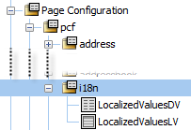
Localized Values
Administrator users can localize values, for example:
Business week
Holidays
Group
Roles
Regions
LocalizedValuesDV.pcf
Contains LocalizedValuesLV.pcf
Notes:
For administrator users managing specific configuration settings for the application, there are two PCFs that assist with localization:LocalizedValuesDV.pcf and LocalizedValuesLV.pcf .
<number>

Slide 61
Describe the significance of separating language and regional format
Recall which PCFs and widgets to always use for person names, contact names, phone numbers, addresses, and money
Configure various PCFs to support regional formats
Identify additional configurations for localization
Notes:
<number>

Slide 62
Explain why localization is more than translation.
Describe a scenario when it is beneficial to independently select language and regional format.
Name four PCFs that facilitate regional formatting.
What setting needs to be configured to for Guidewire application to support multiple currencies?
What is the preferred data element for money? Why?
Notes:
1) Explain why localization is more than translation.
Besides the translation of language, localization is also defined by currency rounding, jurisdiction considerations, address formats, phone formats, and regional formats for names dates, numbers, and currency.
2)Describe a scenario when it is beneficial to independently select language and select regional format.
Formatting is particularly beneficial when dealing with dates, names, currency, address, and phone formats. For example, the French normally use a period and a comma to separate thousands and decimals, e.g. 10.000,00 but some French users prefer to use the reverse convention 10,000.00. So they need to be able to select a regional format that differs from the language.
3) Name four PCFs that facilitate regional formatting.
GlobalContactNameInputSet, GlobalPersonNameInputSet, GlobalPhoneInputSet, and GlobalAddressInputSet.
4) What setting needs to be configured to for Guidewire application to support multiple currencies?
MultiCurrencyDisplay="MULTIPLE" in config.xml
5) What is the preferred data element for money? Why?
Use MonetaryAmount for money. MonetaryAmount stores both the amount and the currency in two columns.
<number>

Slide 63
Notes:
<number>

